Slide 1

Business Intelligence
Azure
Andrew C. Sammut
Lead BI Developer - frerehall capital Management Ltd.
Notes:
Hi all – my name is Andrew Sammut
I lead the Business Intelligence project for our hedge fund. Collection of data from different sources is crucial for us to make important decisions in trading. We try to capture as much data as possible – mainly related to crude oil and natural gas so we can understand the world around us better.

Slide 2
Table of contents
BI Process and Cloud Computing
Azure Analysis Services, Azure function to automate processing
Data Analytics Expressions (DAX)
PowerBI
Summary – quick takes
Q&A
Notes:
So tonight we will be talking about some core technologies in Microsoft Cloud BI – focusing on:
Analysis Services
Powerbi
Data Analytical Expressions
I think PowerBI is probably one of the best tools to come out of Micosoft – it is a great initiative for data. We can see its power from our previous presentation by Markus. A lot of new features are published every month. We will be going through some of the main features tonight.

Slide 3
BI Process
2 main parts:
  Data storage
  Analysis
ETLs
Data Warehouse
Reporting
Dashboards
KPIs
Extracting data from multiple sources,
Cleaning and integrating the data
Data mining, analysis query
Business Intelligence

Slide 4
Online transaction data
Data from multiple sources is extracted, cleaned and processed to eliminate data redundancy and optimised to be stored in a data warehouse.
Main aim of creating a data warehouse:
  Unstructured data -> to one structured common data storage.
Data marts:
  Sometimes it is difficult to process complex analytical queries
  To solve this a warehouse can be broken down into smaller physical units – data marts.

Slide 5

Cloud computing
Provides:
  Capability to process high volumes of data and rapidly growing data over the web
  High availability – replication of machines and nodes to create multiple instances to provide better availability
  Easier to scale up and down – within minutes

Slide 6
Common cloud service models
IaaS
Hosted virtual DB servers
PaaS
“Build Your Own” platforms
SaaS
“BI as a service” apps
Deploy your own solution in the cloud
Low upfront (licensing of VM software etc..
Cloud-based platform services
Low cost, pay-per use
Allows/requires custom development to some extent
Packaged BI solutions
“Easy” management and implementation
No design flexibility; custom apps are off the table
Infrastructure as a Service (IaaS)
Platform as a service (PaaS)
Software as a service (SaaS)
Notes:
Paas are Cloud-based platform services like for example Azure Analytical Services which we will discuss in a few.

Slide 7
Table of contents
BI Process and Cloud Computing
Azure Analysis Services, Azure function to automate processing
Data Analytics Expressions (a.k.a DAX)
PowerBI
Summary – quick takes
Q&A

Slide 8
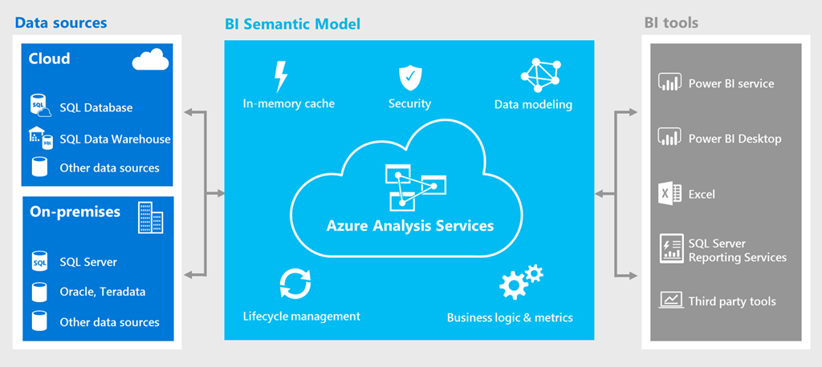

Azure Analysis Services
Announced in Q2 2017.
Fully managed platform as a service (PaaS).
Create a server within minutes.
Currently supporting only Tabular models.
Supports latest client tools:
  Excel, Powerbi, Tableau
Scale to your needs.

Slide 9

AAS tiers
Feature | Developer | Basic | Standard
Perspectives
Multiple Partitions
DirectQuery
Translations
Dax Calculations
Row-level security
In-mem storage
Back up and restore

Slide 10
AAS tiers
Instance | QPUS | Memory (GB) | Price
Developer | 20 | 3 | $0.132/hour
B1 | 40 | 10 | $0.43/hour
B2 | 80 | 20 | $0.86/hour
S0 | 40 | 10 | $0.81/hour
S1 | 100 | 25 | $2.03/hour
S2 | 200 | 50 | $4.06/hour
S4 | 400 | 100 | $8.11/hour
S8 | 320 | 200 | $10.38/hour
S9 | 640 | 400 | $20.76/hour

Slide 11
In-Memory vs DirectQuery
In-Memory | DirectQuery
Data is processed and compressed using the xVelocity in-memory engine (formerly called VertiPaq). | Lets users retrieve data directly from SQL Server data source in real-time. DAX queries – transformed in SQL statements to query relational data source.
The server needs lots of memory if you have a lot of data in facts tables. | Allows data sets that are too large to fit in-memory.
The data is not updated, | Data is considered to be up-to-date.
Provides fast query times for aggregation queries. | Reduced memory use, CPU use, and improved start time by Analysis Services.
DAX measures, calculated columns, and time intelligence functions are all supported. | Calculated columns and some DAX functions are not supported.
Can be created in PowerPivot and SSDT. Can be /deployed on Analysis Services instance | Cannot be created in PowerPivot. One can only deploy in a Analysis Services instance.

Slide 12
Server resource usage during processing (In-Memory) – processing 24mill rows
Network usage: In this case SQL server is located in a separate server. Therefore, network resources are used until all 24 million rows are read and encoded.
Memory usage: Steadily grows as 16mill rows of uncompressed data are read and encoded. Spike occurs as the 16 mill rows are split into 2 segments and compressed. Memory usage drops slightly. ProcessRecalc begins – memory usage is dependent on the complexity and size of calculated columns.
Processor Memory Network
Processor usage: Server in test – 4 cores. While reading and encoding first 16 million rows, approx. 1 core (25% CPU) is used. Then reading and encoding of segment 3 begin in parallel with seg.1 & 2 being compressed (75% CPU).
  ProcessRecalc begins – depending on complexity of calc columns, a spike of CPU can be seen until the columns, hierarchies and relationship structures are built.
Link to Hardware sizing whitepaper:
https://msdn.microsoft.com/en-us/library/jj874401.aspx?f=255&MSPPError=-2147217396
Notes:
This is an interesting diagram which shows how the Processor, Memory and the Network are affected during processing

Slide 13
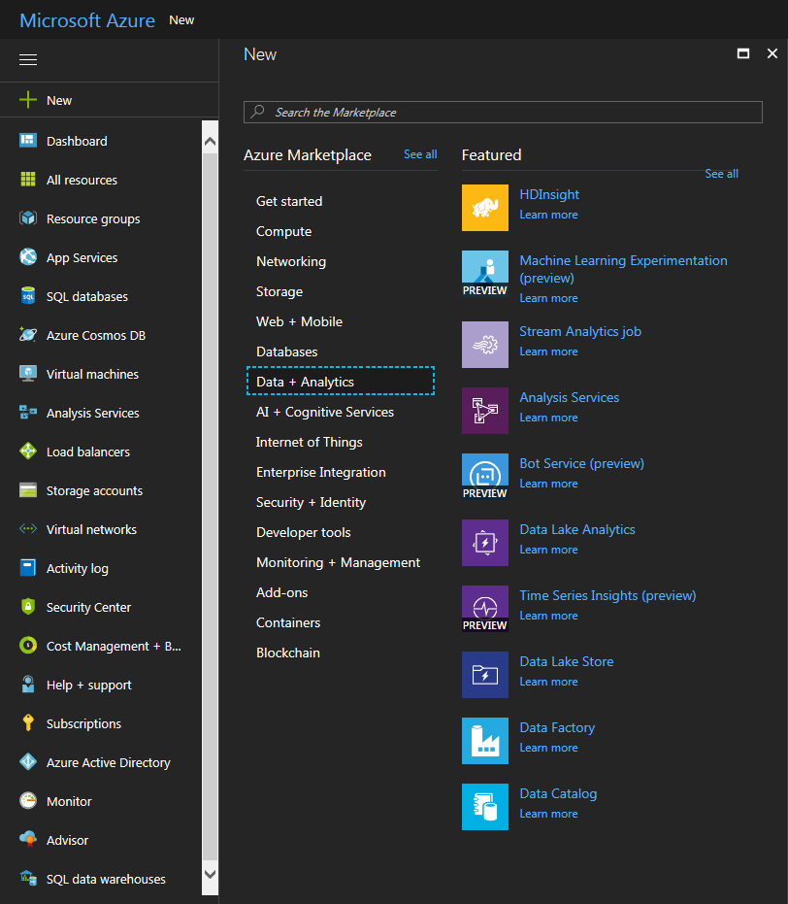
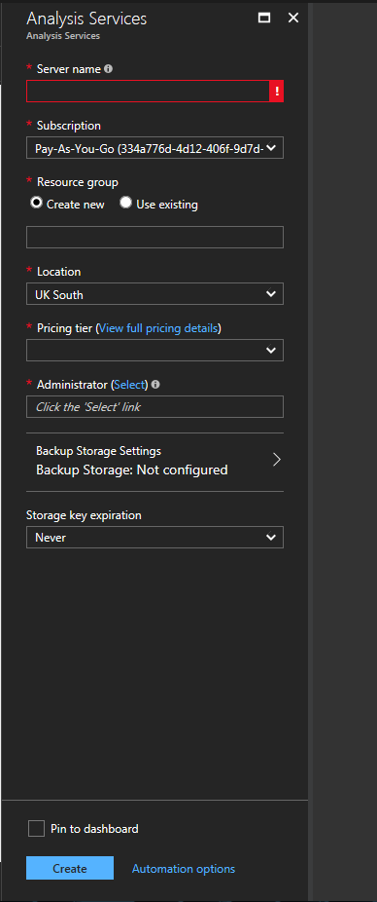
Creating an AAS instance

Slide 14
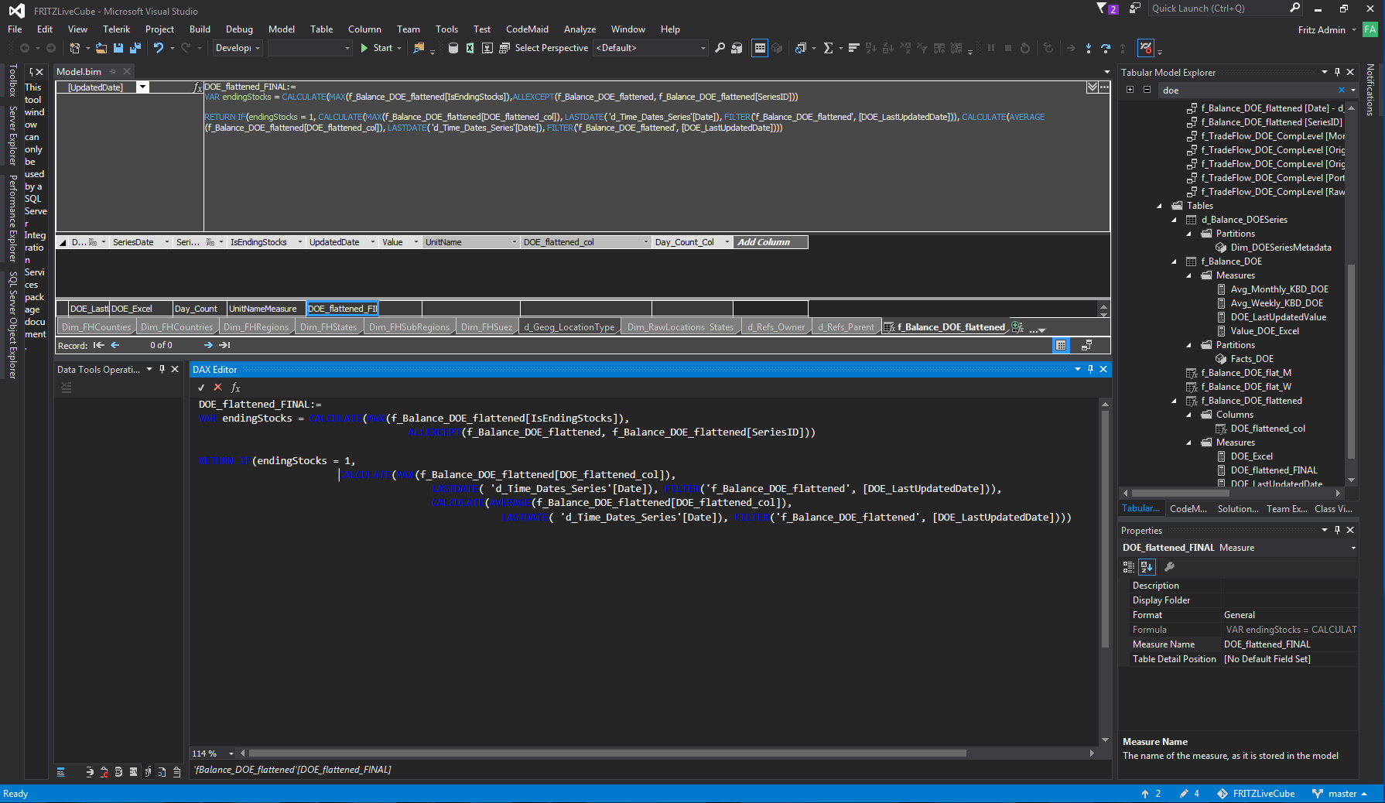
SSDT – Visual Studio

Slide 15
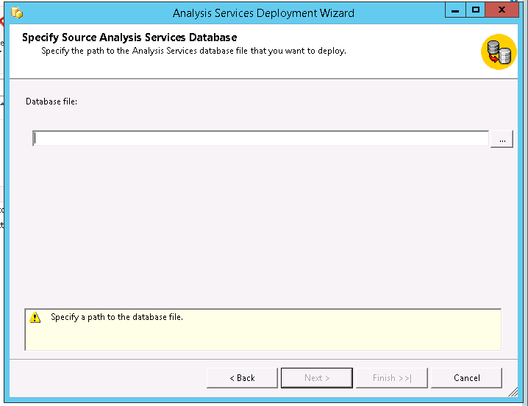
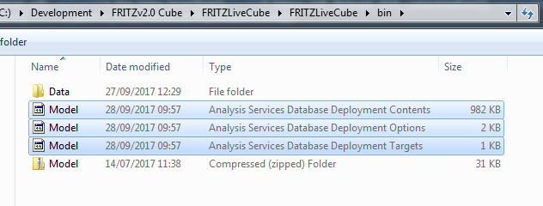
Analysis Services Deployment Wizard

Slide 16
Automating AAS model processing
Demo
Notes:
I will show the steps to create an azure function and the libraries we need to make it process the model automatically.
However I won’t process the model as it will take some time and we want to create a pbi report later on.

Slide 17
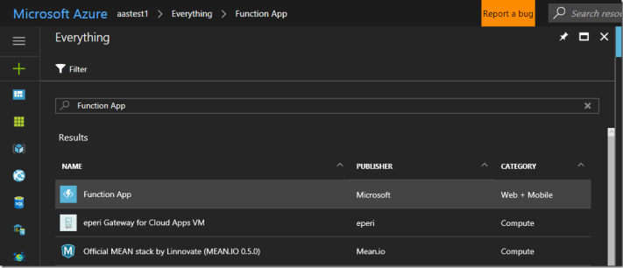
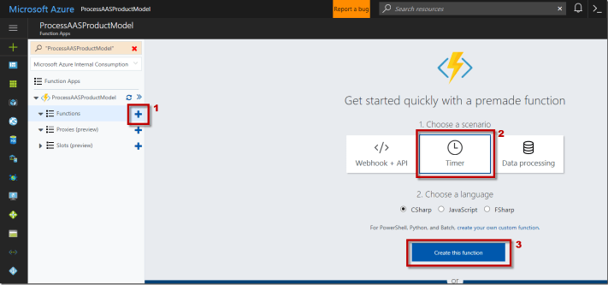
Automating AAS model processing
1. Create an Azure function app
2. Create a new function

Slide 18
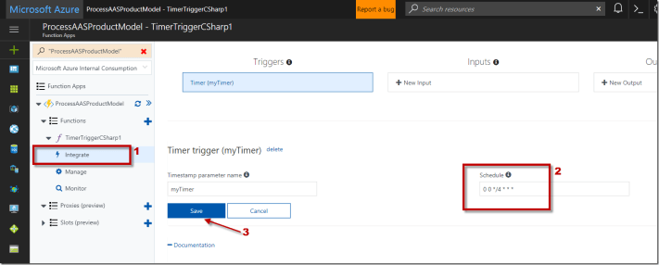
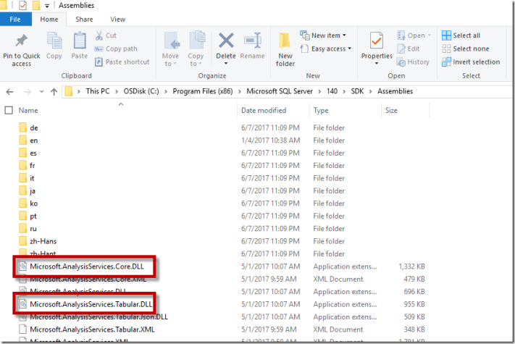
3. Configure the timer
  Using CRON Expression
4. Configure the function App
  Download latest client libraries for Analysis services:
    https://docs.microsoft.com/en-us/azure/analysis-services/analysis-services-data-providers
  The 2 files we need:
    C:\Program Files (x86)\Microsoft SQL Server\140\SDK\Assemblies\Microsoft.AnalysisServices.Core.DLL
    C:\Program Files (x86)\Microsoft SQL Server\140\SDK\Assemblies\Microsoft.AnalysisServices.Tabular.DLL
Notes:
- It is important that we use 140 and not 130 as if not it will throw exceptions.

Slide 19
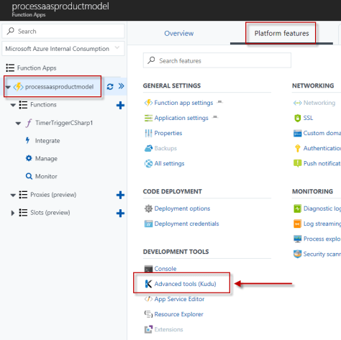
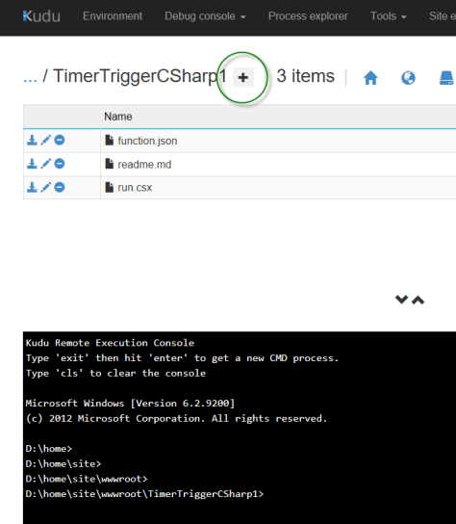
Go to Advanced (Kudu)
Click Debug console and select CMD
Navigate to: site\wwwroot\TimeTriggerCSharp1
Add a bin folder here

Slide 20
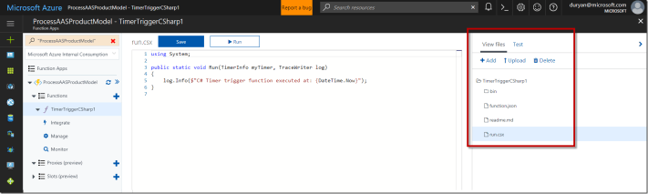
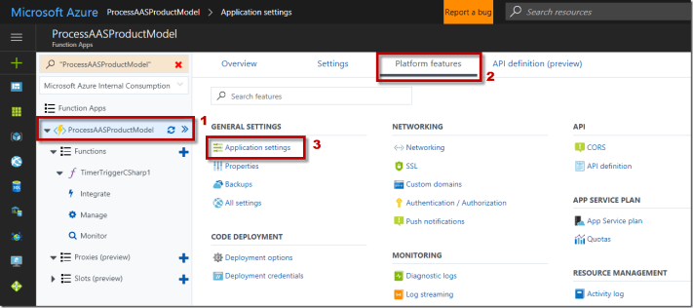
On the right under View files, navigate to bin folder. Then click upload to upload the bin files
Add the connection string for the azure analysis database
We need:
  AAS server name
  User ID and password (that has access to AAS)

Slide 21
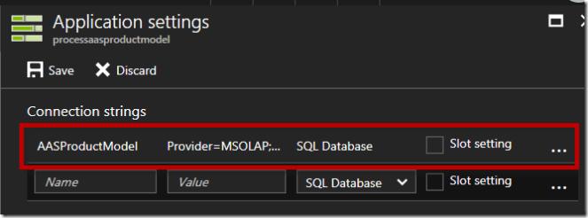
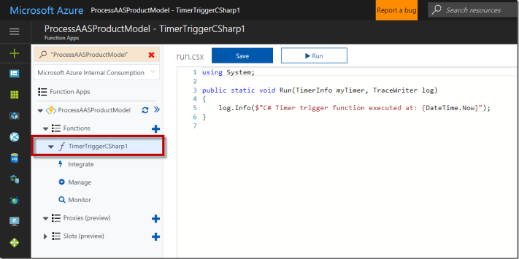
Add your connection string in the application settings.
Time to add some code

Slide 22
Processing types - Database
Process default
Process full
Process clear
Process recalc:
Updates and recalculated hierarchies, relationships and calculated columns
Removes all data from database objects.
Processes a database and all the objects that it contains.
Detects the process state of database objects, and performs processing necessary to deliver unprocessed or partially processed objects to a fully processed state.
Clears and processes from scratch.

Slide 23
Processing types - Table
Process full
Process data
Process clear
Process defrag
Degragments the auxiliary table indexes
Removes all data from a table and any table partitions
Load data into a partition or a table without rebuilding relationships or calculated columns
Processes a table and all the objects it contains

Slide 24
Processing types - Partition
Process full
Process data
Process clear
Process add
Incrementally update partition with new data
Removes all data from a partition.
Load data into a partition or a table without rebuilding relationships or calculated columns
Processes a partition and all the objects it contains

Slide 25

Tabular model performance
For best query performance is mostly dependent upon these 3 factors:
  Amount, bandwidth, and speed of memory
  Fast CPUs
  Onboard cache size

Slide 26
Profiler trace events
Events sub class | Explanation
1 – Process | The duration of the progress report end event tells you how long the ProcessData phase took. The ProcessRecalc phase begins later.
25 – ExecuteSQL | The SQL query run for that partition
17 – ReadData | This event fires when the first row is read from the relational data source. If the CurrentTime on this event is delayed – then the SQL query was slow to return rows. If this happens – optimise SQL query.
53 – VertiPaq | Event fired when data compression starts
54 – Hierarchy processing | A long duration on the Process Report End means that we have an expensive hierarchy. Consider removing the column/reducing its cardinality.

Slide 27
Profiler trace events
Events sub class | Explanation
46 – Relationship Build Prepare | A long duration on the Progress Report end event indicates this relationship was complex to build. Unfortunately, this event does not identify which table is on the other end of the relationship or which columns are related.
6 – Commit | Long duration indicates that a longrunning query is blocking the commit or an I/O bottleneck.

Slide 28
Memory limits
Processing:
  During processing, SSAS needs memory to load data and create dictionaries and other data structured before it flushes them to disk.
Querying:
  SSAS sometimes needs memory to hold temporary data to resolve queries.
BISM Memory Report
Download from:
  https://www.powerpivotblog.nl/what-is-using-all-that-memory-on-my-analysis-server-instance/

Slide 29
Memory setting
Hard memory limit - 0:
  Max memory the system can have. If this is exceeded, active sessions will be killed. If set to default 0, it will use the value midway between the high memory limit and total total physical memory.
Low memory limit - 65:
  The point where the system will begin cleaning memory out of caches.
Total memory limit - 80:
  High memory limit – if exceeded memory manager will evict all cached data which is not currently in use. Must always be less than hard memory limit.
Vertipaq memory limit – 60
  If total memory used by VertiPaq exceeds the VertiPaqMemoryLimit, the memory used by VertiPaq in excess of the limit will be ignored.
Vertipaq paging policy - 0:
  Mode 0 – Locked – Lock all VertiPaq data in memory
  Mode 1 – Allow system paging – Lock only hash dictionaries in memory – allow VertiPaq data to exceed total physical memory
For more in-depth view please read this whitepaper: https://msdn.microsoft.com/en-us/library/dn393915.aspx
Notes:
For example, say VertiPaqMemoryLimit is 100GB, LowMemoryLimit is 110GB, and TotalMemoryLimit is 120GB. Now assume that VertiPaq data structures are using 210GB of memory, and the process’ total memory usage is 215GB. This number is well above the TotalMemoryLimit (and probably above HardMemoryLimit), so ignoring VertiPaqMemoryLimit, the cleaning would be very aggressively, and would kill sessions. However, when PagingPolicy is 1, the memory used by VertiPaq in excess of the limit is ignored for the purpose of computing memory pressure. This means that the number used is <Total Memory> (215GB) – <Total VertiPaq Memory>(210GB) + <VertiPaqMemoryLimit>(100GB) = 105GB, which is below the LowMemoryLimit, so the cache is not cleaned at all.
https://www.sqlbi.com/articles/memory-settings-in-tabular-instances-of-analysis-services/

Slide 30
Azure Memory Metrics
Demo

Slide 31
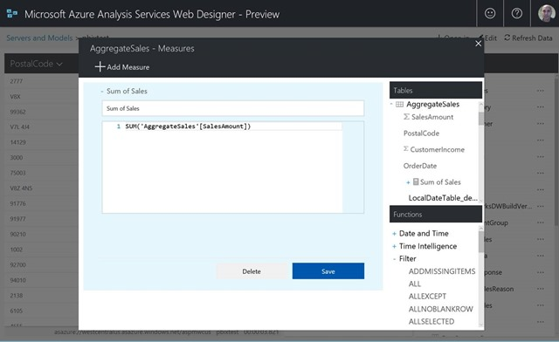
AAS web designer
Released on July 20, 2017
New browser-based experience to allow us to create and manage AAS semantic model.
SSDT and SSMS still primary tools – this is a new way to make simple changes fast and easy.
One can also import a pbix file (in-memory models only).
Best practice:
  Do changes to development server and propagate changes to production with a tools such as BISM Normlizer

Slide 32
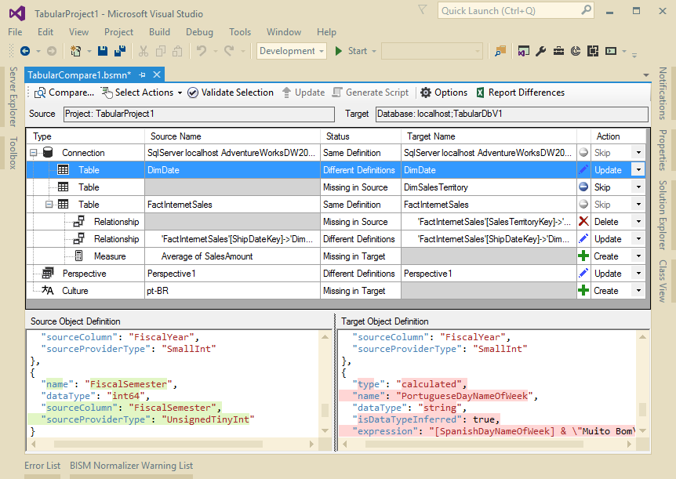
BISM Normaliser
Database compare
  Compare schemas between models
Code merging
  Merge branched models. Manage production branches for bug fixes
Easy deployment
  Deploy bug fixes and partial releases.
Download from VS gallery:
  https://visualstudiogallery.msdn.microsoft.com/f7ebe632-878c-4640-b035-a143d1dd1cf3

Slide 33
BISM Normaliser
Demo

Slide 34

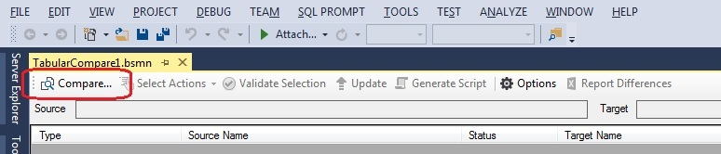
How to use?
Click on New Tabular Model Comparison
Click Compare

Slide 35
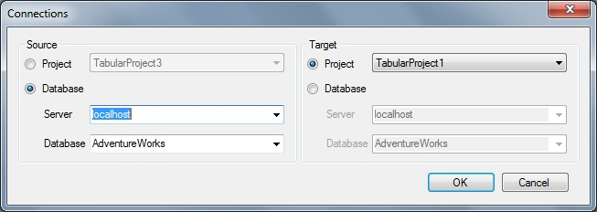
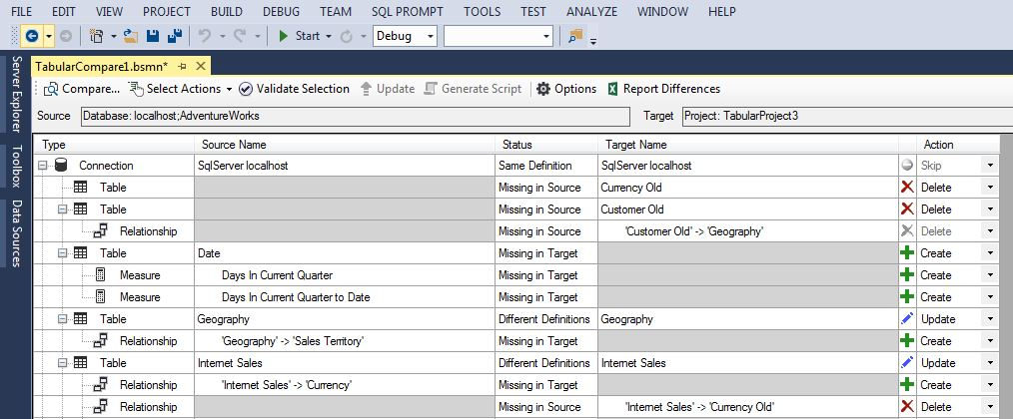
How to use?
Compare to target project/database

Slide 36
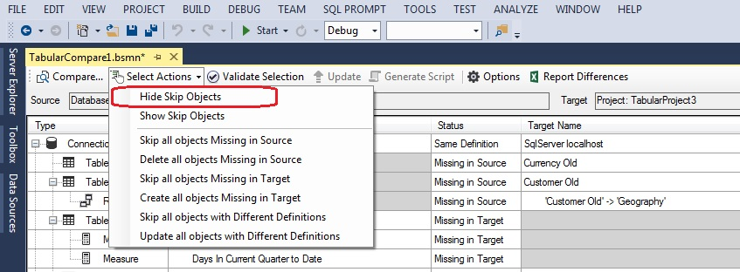
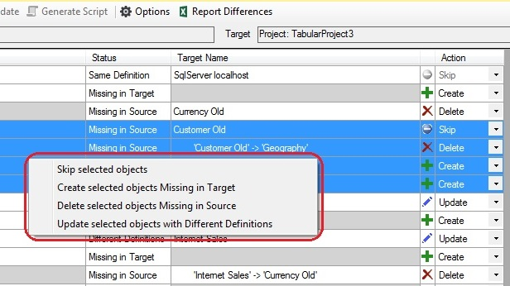
How to use?
Hide skip objects to focus on differences
Actions available are Create, Update and Delete.
Select options using the dropdowns in Action column

Slide 37
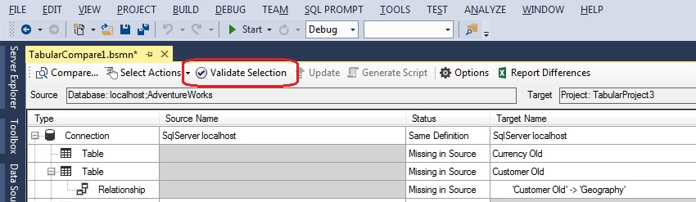
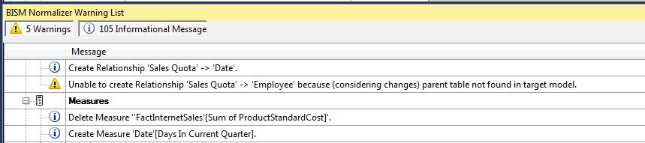
How to use?
Click Validate Selection
Check any warning in the BISM Normaliser Warning List.

Slide 38
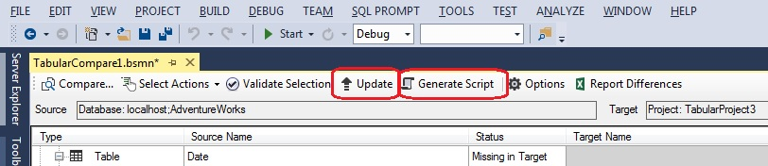
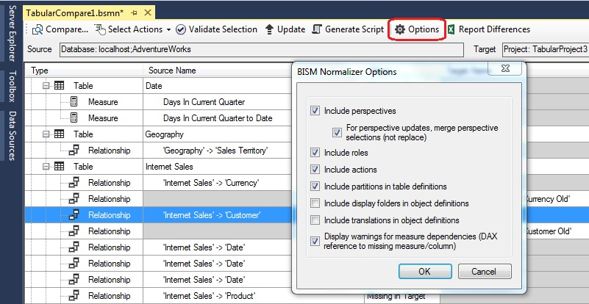
How to use?
Update the target or script changes.
Comparison options can be set in the Options dialog.

Slide 39
Table of contents
BI Process
Azure Analysis Services, Azure function to automate processing
Data Analytics Expressions (a.k.a DAX)
PowerBI
Summary – quick takes
Q&A

Slide 40
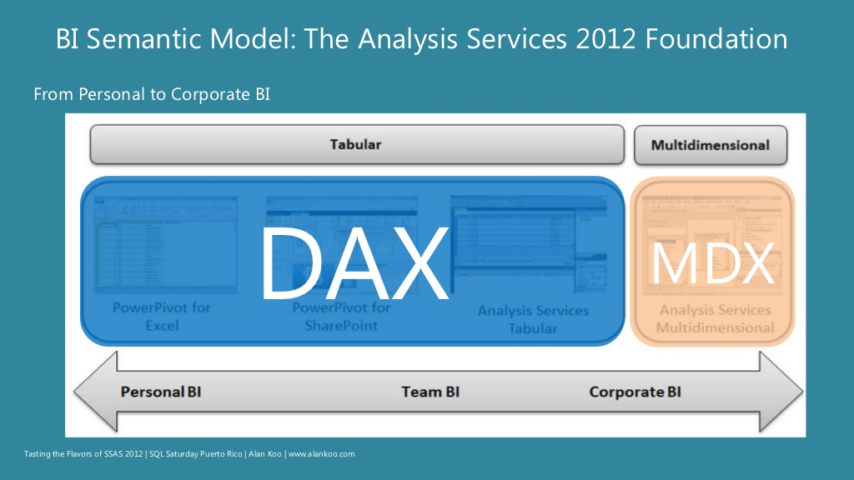
The DAX Language
DAX is not Excel
DAX is not SQL
DAX is not MDX
DAX is painful if we don’t get this.
The concepts are harder than the syntax.
Once you grasp the concept the syntax should be easy.

Slide 41
4 important concepts
Calculated Columns
Calculated Measures
Row
Context
Filter
Context

Slide 42
Calculated columns vs measures
Calculated columns:
  Calculations stored in the database
  Formula is evaluated for each row
  Columns can be used for both slicing data and summarizing values
  Computed at process time thus can consume a lot of RAM
  Can be used in filters or value/result areas
  Computed while processing the model
Measures:
  Computed on aggregates of values shown at the current context
  Computed at query time
  Evaluated dynamically per value in PivotTable
  Computed are run-time
Prefer measures, whenever possible

Slide 43
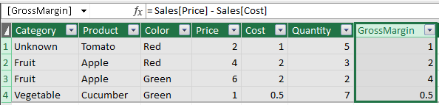
Example – Calculated Columns

Slide 44
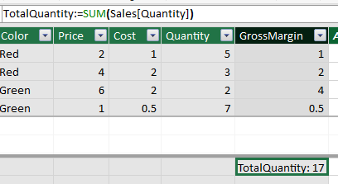
Example - Measure
TotalQuantity := SUM(Sales[Quantity])

Slide 45
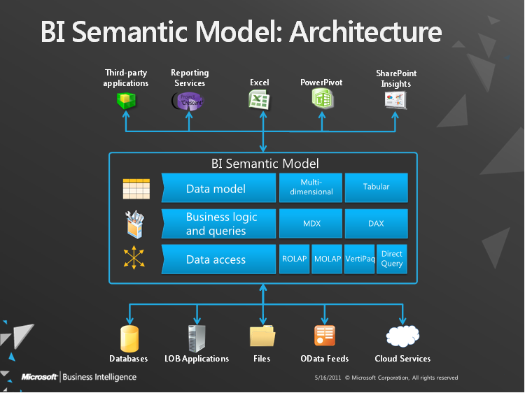
DAX is good at 2 things
Aggregations
Filtering:
  Implicit
  Explicit

Slide 46
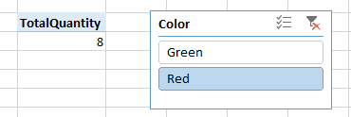

Implicit filtering
Using slicers
Cell locations
Notes:
Filtering created from the user’s side when creating reports, by using:
Slicers
Cell locations within the report

Slide 47

Explicit filtering
Explicit filtering supersedes implicit filtering.
GreenQuantity := CALCULATE(SUM(Sales[Quantity]), Sales[Color]="Green")

Slide 48
Filtering context
A combination of implicit and explicit filtering
Calculate function allows one to overwrite the filter context
  Aka the ‘Queen of DAX’
  More complex to work with than other functions – but very powerful
  One can use a set of filter arguments to modify the Filter Context.
Calculate function:
  Calculate(<expression>,<filter1>,<filter2>,…)

Slide 49
Filtering – which are better iterators or filter
CALCULATE(SUM(Sales[Quantity]), Sales[Price] - Sales[Cost] <= 1)
The statement function above causes a semantic error:
  “The expression contains multiple columns, but only a single column can be used in a True/False expression that is used as a table filter expression”.
To solve this error we have to use the DAX iterators.
  Eg. SUMX, AVGX, MAXX, MINX
These iterators work a calculation row by row rather than on a chunk of data.

Slide 50
SUM vs SUMX
SUMX is an iterator
  Unlike SUM which can operate on blocks of data it steps through the data row by row
  Might be timeconsuming and inefficient.
  Only use SUMX when you cannot use SUM.
Question: If I gave you 6 oranges every day for 5 days how many oranges would you have?
  Answer: 5 x 6 = 30 (right away – SUM in action)
  3-year-old answer: 6 + 6 + 6 + 6 + 6 = 30 (SUMX in action)
Example:
  TotalSales := SUMX ( Sales, Sales[Quantity] * Sales[UnitPrice])

Slide 51
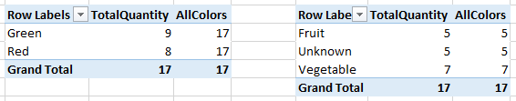
All function
Removes unwanted filtering
Can be applied to a table and/or specific column
AllColours := CALCULATE(SUM(Quantity), ALL(Sales[Colour]))

Slide 52
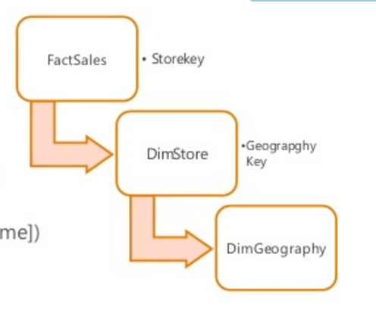
RELATED Function
More powerful than VLOOKUP:
  VLOOKUP only returns 1st match
RELATED(COLUMN):
  Travels many to one direction
  Can travel multiple relationships
  Add calculated columns to FactsSales
    =RELATED(DimStore[StoreName])
    =RELATED(DimGeography[ContinentName])

Slide 53


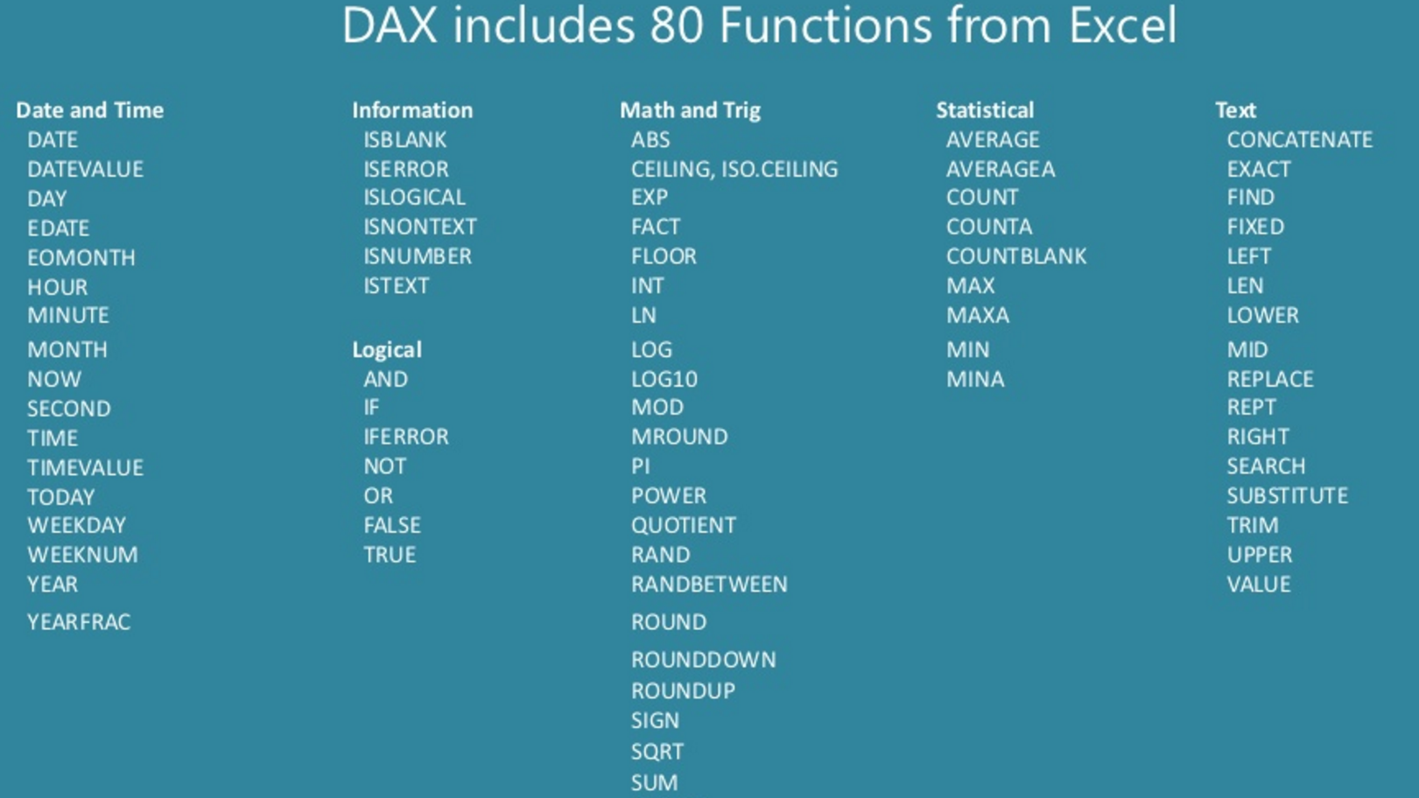




Slide 54
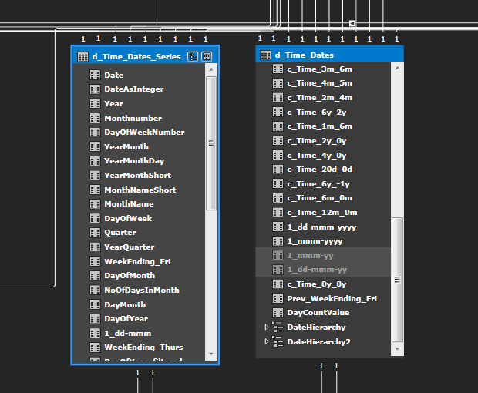
Dates in Calculated tables

Slide 55
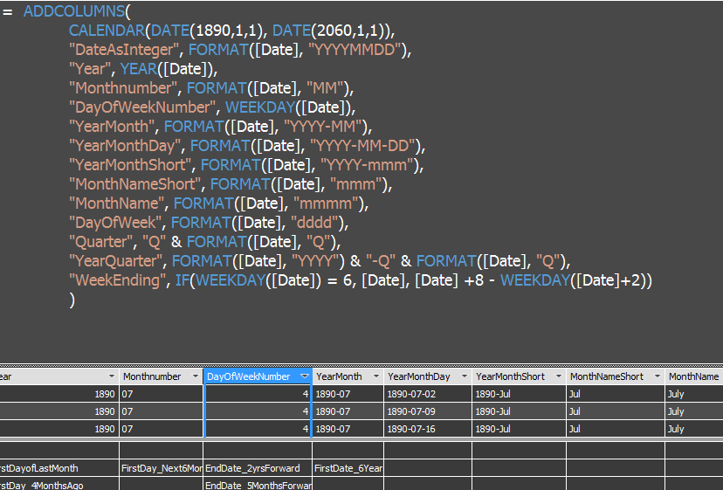
DAX Code - Dates table

Slide 56
Golden rules when working with Date tables
Separate
Always create a separate Date table.
Make
Make sure your date table has a continues date range
Create
Create relationships between fact tables and the Date table
Never
Never use date column from the fact table in time functions
Mark
Mark the Date table as a Date Table and set the Date column

Slide 57
Time Intelligence Example formulas
Time Period | Formula
MTD | = CALCULATE(SUM([RigCount]), DATESMTD(Dim_DateTime[Date]))
QTD | = CALCULATE(SUM([RigCount]), DATESQTD(Dim_DateTime[Date]))
YTD | = CALCULATE(Sum([RigCount]), DATESYTD(Dim_DateTime[Date])
PriorYearMTD | = CALCULATE(Sum(RigCount]), DATEADD(DATESMTD(Dim_DateTime[Date]), -1, YEAR)
PriorYearQTD | = CALCULATE(Sum(RigCount]), DATEADD(DATESQTD(Dim_DateTime[Date]), -1, YEAR)
PriorYearYTD | = CALCULATE(Sum(RigCount]), DATEADD(DATESYTD(Dim_DateTime[Date]), -1, YEAR)

Slide 58
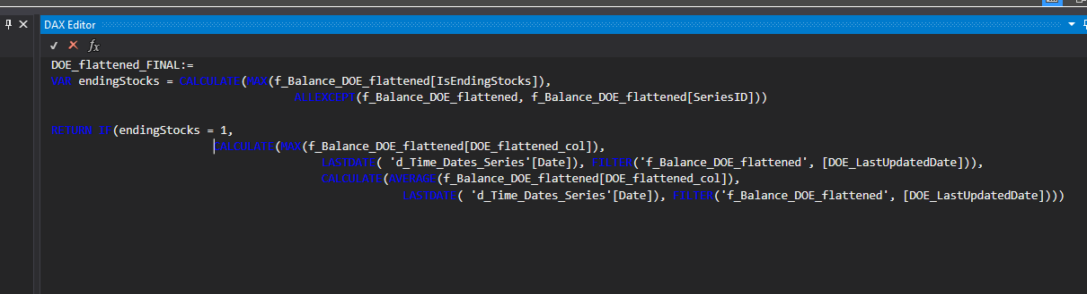
DAX Editor
Code highlighting
No intellisense
Download from:
  http://daxeditor.codeplex.com

Slide 59
Table of contents
BI Process
Azure Analysis Services, optimisations, Azure functions
Data Analytics Expressions (a.k.a DAX)
PowerBI
Summary – quick takes
Q&A

Slide 60
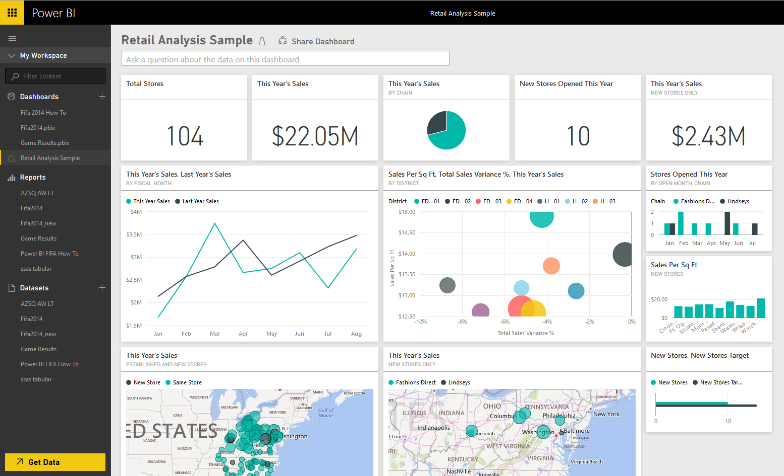
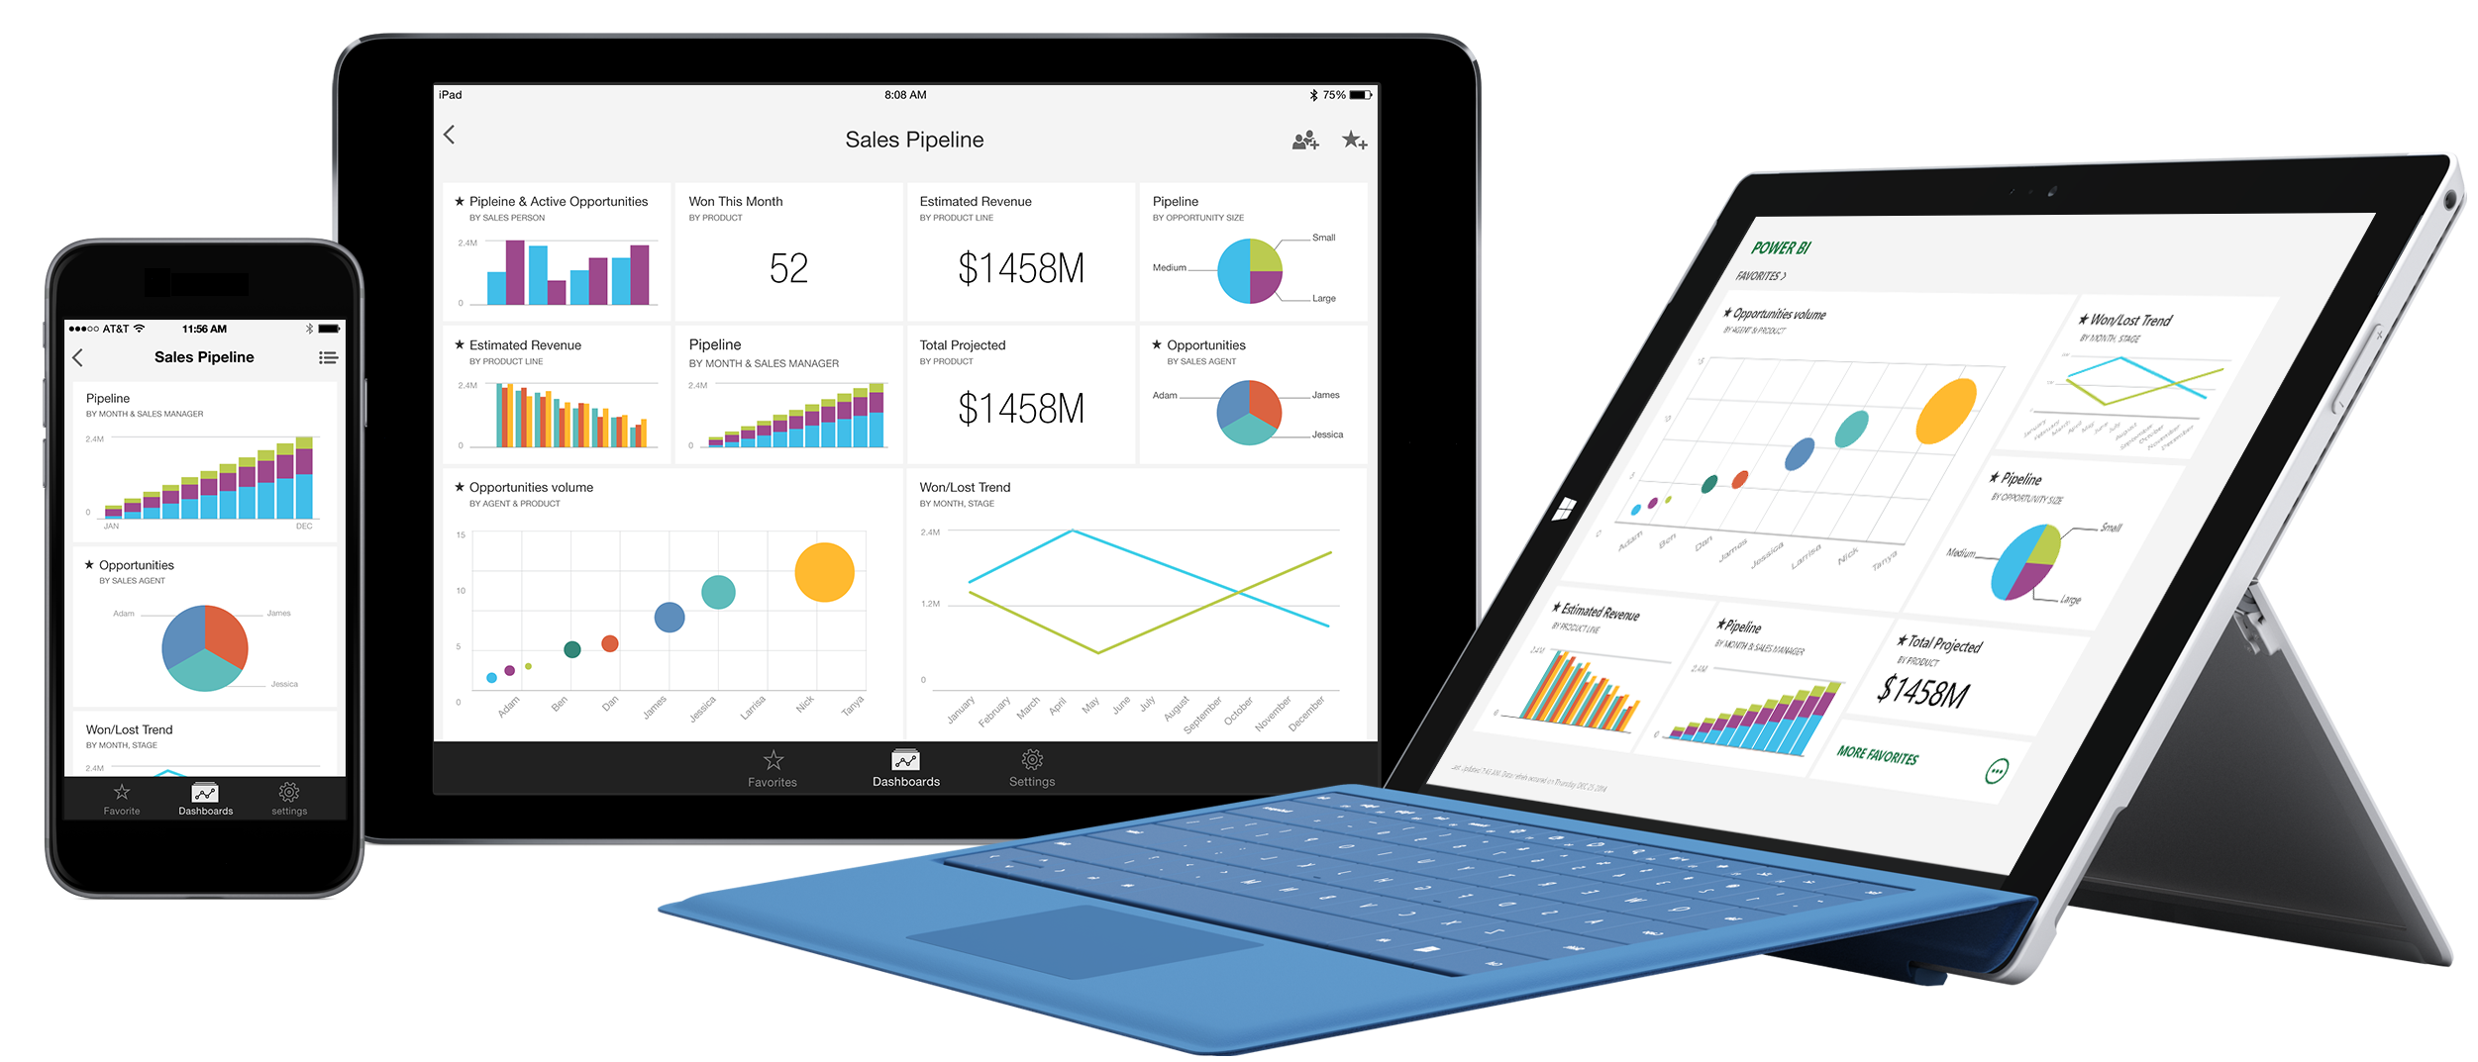
Power BI: experience your data

Slide 61
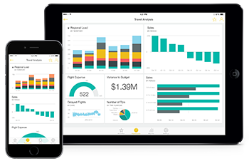
Power BI: experience your data
A fully cloud-based self-service BI offering: powerbi.com
Mobile compatible
A very powerful tool having the features of the following:
  Power Query: Data mash up and transformation tool
  Power Pivot: In-memory tabular data modelling tool
  Power View: Data visualisation tool
  Power Map: 3D Geo-spatial data visualization tool
  Power Q&A: Natural language question and answering engine
  Power BI Desktop: A powerful companion development tool for PowerBI

Slide 62
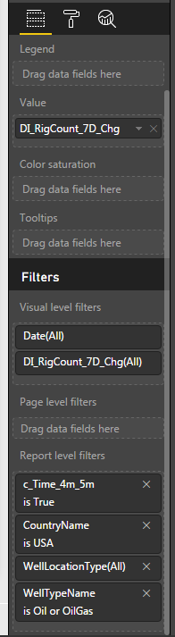
PowerBI Filtering
Visual level filters
  Affects only the visual in the page
Page level filters
  Filters the whole page in a report
Report level filters
  Sets the filter for the whole report

Slide 63
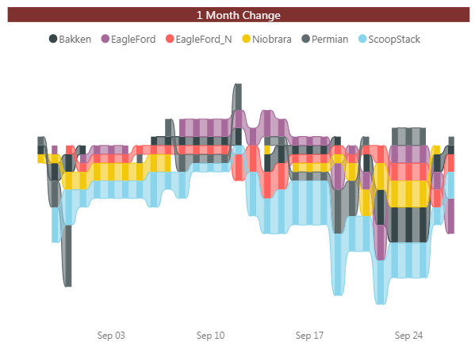
PowerBI Latest features – Sep 2017
Constantly new updates – every 3-4 weeks
Report View:
  Drillthrough to another report page
  Ribbon chart
  Gridline style control
New custom visuals:
  Calendar by Tallen
  Impact bubble chart
A nice to have which is still in development:
  PowerBI Embedded with AAS

Slide 64
Demo
Notes:
Canada remained the largest exporter of total petroleum to the United States in June; exporting 3.8 million b/d. The second largest exporter of total petroleum was Saudi Arabia with 1.0 million b/d.

Slide 65
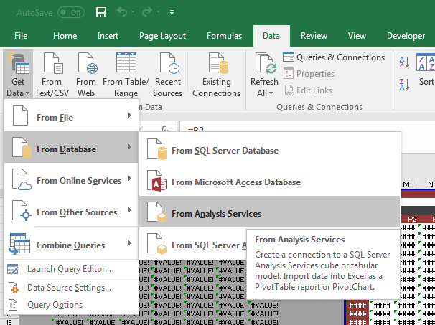
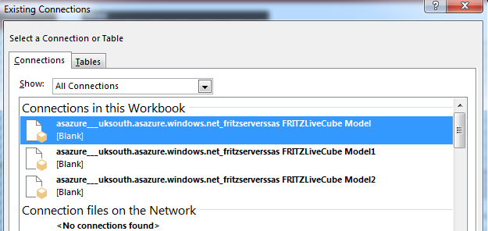
AAS in Excel

Slide 66
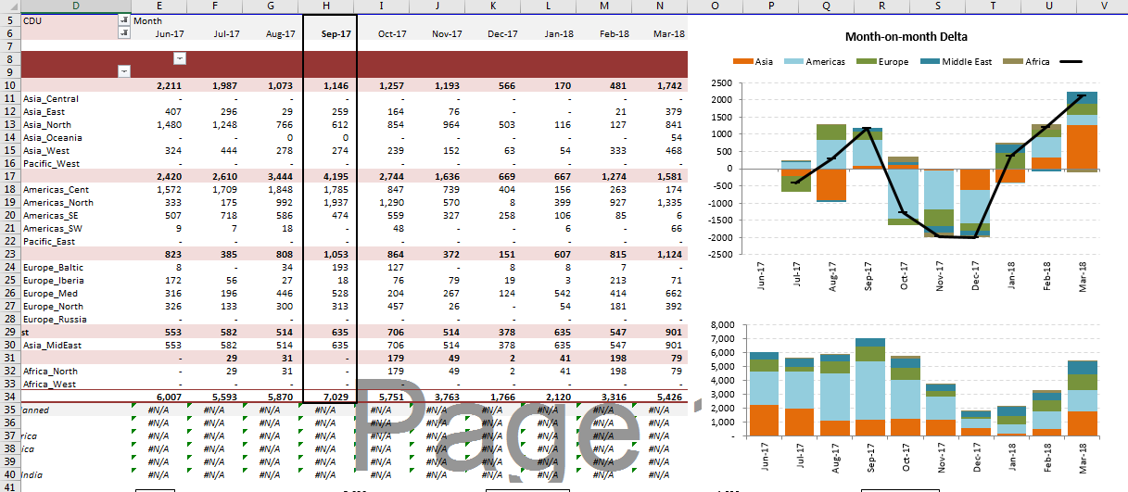
AAS in Excel

Slide 67

Pivot table data cache
Data cache: internal memory used by Excel to store data for the report.
Used to reduce improve performance and reduce the size of your workbook.
However, there may be time when you do not want to share data cache between 2 or more PivotTable reports, example:
  You do not want calculated field and items to be displayed in all the PivotTable reports.
  You do not want fields to be grouped in the same way in all PivotTable reports.
  You do not want al the PivotTable reports to refresh at the same time.
One can unshare the data cache simply by:
  Creating a unique data connection for each PivotTable report in a workbook.
Tip: To see how many data caches there are in a workbook, Visual Basic Editor and type the following: ?ActiveWorkbook.PivotCaches.Count
https://support.office.com/en-us/article/Unshare-a-data-cache-between-PivotTable-reports-87188806-0c24-4d17-b2f7-9e3a4a05542b

Slide 68
Table of contents
BI Process
Azure Analysis Services, optimisations, Azure functions
Data Analytics Expressions (a.k.a DAX)
PowerBI
Summary – quick takes
Q&A

Slide 69
Summary/Quicktakes
Use in-memory when we need very fast query times for aggregations - use DirectQuery when data is too large to fit in-memory
DAX – focus on how context filtering works
Prefer measures over calculated columns whenever possible
Time intelligence: Always work with a separate time dimension and connect the facts with this Date table
Take care of data cache from Excel side

Slide 70
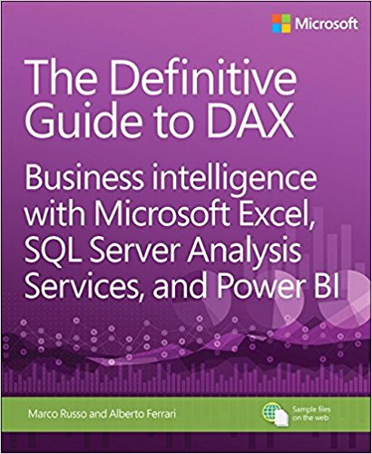
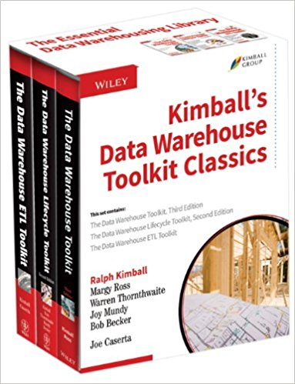

Some resources
https://sqldusty.com/2017/06/21/how-to-automate-processing-of-azure-analysis-services-models/
http://www.jamesserra.com/archive/2012/06/tabular-query-modes-directquery-vs-in-memory/
http://www.kimballgroup.com/2009/05/the-10-essential-rules-of-dimensional-modeling/
http://www.powerpivot-info.com/
https://javierguillen.wordpress.com/
https://blog.crossjoin.co.uk/
http://sqlblog.com/blogs/marco_russo/
PowerBI slack group:
  https://ec82.typeform.com/to/NUDh0l
PowerBI blog:
  https://powerbi.microsoft.com/en-us/blog/

Slide 71




Thank you
QUESTIONS?
Andrewcarlsammut@gmail.com
https://www.linkedin.com/in/andrew-sammut-a8646369
@andcsammut

